Slide 1


CSE 491:CLOUD COMPUTING
Course Overview
Jannatun Noor
Lecturer,
BRAC University
Jannatun.noor@bracu.ac.bd
More about me: https://sites.google.com/site/jannatun0abigzero/

Slide 2
Necessary Information
From TSR [in BRACU] [Not reachable in Corona Time]
From BUX [You can access it outside BRACU also]
From my site https://sites.google.com/site/jannatun0abigzero/teaching
Marks will be updated on this site.
Slides are also available there

Slide 3
Tentative Mark Distribution
Section | Marks (%)
Quizzes/Class Tests/Assignments/Projects | 50% - 60%
Mid Term Examination | 10 %
Lab | 20 -30%
Final | 10 %
Total | 100 %

Slide 4
Assignments & Projects !!! 50~60 marks
Will be given BUX platform
Submit the assignments at due time.
No assignment will be allowed after the deadline. [Strictly]
Never ignore assignments. That will lower your grade.

Slide 5
Books and Resources
No need to follow any exact book.
For gaining knowledge you can follow any book related to Cloud Computing.
Will cover topic based on practical requirements on recent industries.
Mainly focus on DEV-OPs Concept [Development and operation]

Slide 6
Books and Resources
CloudComputingTheoryAndPractice by Dan C.. Marinescu.
Cloud Computing: from beginning to end by Ray J. Rafals

Slide 7
Be ready to work with LINUX operating system
Don't be afraid, learning a new operating system is always fun
You must need to setup Linux operating system in your PC. I will suggest you to setup Ubuntu operating system in dual boot mode.
Without Ubuntu, you can’t complete any of your tasks!!!
You can also install VMware/virtualBox, and inside the software install a Ubuntu virtual machine.
That will need a two level virtualization to complete the assignments hence I always suggest to install ubuntu in your HOST machine.

Slide 8
Topics to cover
No. | Topic details | Time allocation
1 | Cloud computing basic; Virtualization in cloud | Week 1,2
2 | Containerization; Storage systems - File storage, Block Storage, Object Storage | Week 3,4
3 | Message Broker - RabbitMQ/ ZeroMQ/Qpid; Cache - Memcached/Redis | Week 5
4 | Review and midterm | Week 6
5 | SDS, Object storage system OpenStack Swift installation | Week 7-9
6 | RDBMS - MySql, MariaDB, Postgresql; Components of a cloud | Week 10
7 | Software defined networking; Openstack PackStack installation | Week 11
8 | Course Review/Discussion | Week 12

Slide 9
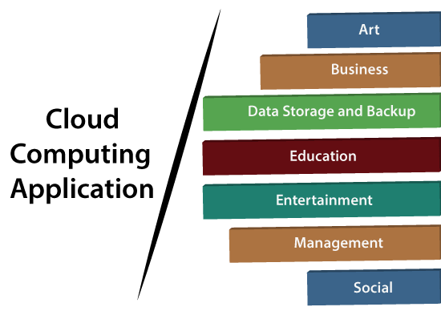

Slide 10
“Cloud is about how you do computing, not where you do computing.”
~ Paul Maritz, CEO of VMware
“If someone asks me what cloud computing is, I try not to get bogged down with definitions. I tell them that, simply put, cloud computing is a better way to run your business.”
~ Marc Benioff, Founder, CEO and Chairman of Salesforce

